Slide 1
Database and Programming Concept
Prepared By
Mehedi Hasan Imran
Lecturer, BAUET
Dept. of ICE

Slide 2
Database Management System
What is Database?
The database is a collection of inter-related data which is used to retrieve, insert and delete the data efficiently. It is also used to organize the data in the form of a table, schema, views, and reports, etc.
For example: The college Database organizes the data about the admin, staff, students and faculty etc.
Using the database, you can easily retrieve, insert, and delete the information.
Characteristics of DBMS
It uses a digital repository established on a server to store and manage the information.
It can provide a clear and logical view of the process that manipulates data.
DBMS contains automatic backup and recovery procedures.
It contains ACID properties which maintain data in a healthy state in case of failure.
It can reduce the complex relationship between data.
It is used to support manipulation and processing of data.
It is used to provide security of data.
It can view the database from different viewpoints according to the requirements of the user.

Slide 3
Advantages of DBMS
Controls database redundancy: It can control data redundancy because it stores all the data in one single database file and that recorded data is placed in the database.
Data sharing: In DBMS, the authorized users of an organization can share the data among multiple users.
Easily Maintenance: It can be easily maintainable due to the centralized nature of the database system.
Reduce time: It reduces development time and maintenance need.
Backup: It provides backup and recovery subsystems which create automatic backup of data from hardware and software failures and restores the data if required.
multiple user interface: It provides different types of user interfaces like graphical user interfaces, application program interfaces
Disadvantages of DBMS
Cost of Hardware and Software: It requires a high speed of data processor and large memory size to run DBMS software.
Size: It occupies a large space of disks and large memory to run them efficiently.
Complexity: Database system creates additional complexity and requirements.
Higher impact of failure: Failure is highly impacted the database because in most of the organization, all the data stored in a single database and if the database is damaged due to electric failure or database corruption then the data may be lost forever.

Slide 4
Relational Database Management Systems(RDBMS)
RDBMS stands for Relational Database Management Systems. All modern database management systems like SQL, MS SQL Server, IBM DB2, ORACLE, My-SQL and Microsoft Access are based on RDBMS. It is called Relational Data Base Management System (RDBMS) because it is based on relational model introduced by E.F. Codd. Data is represented in terms of tuples (rows) in RDBMS.
Relational database is most commonly used database. It contains number of tables and each table has its own primary key.
Due to a collection of organized set of tables, data can be accessed easily in RDBMS.

Slide 5
DBMS | RDBMS
DBMS applications store data as file. | RDBMS applications store data in a tabular form.
In DBMS, data is generally stored in either a hierarchical form or a navigational form. | In RDBMS, the tables have an identifier called primary key and the data values are stored in the form of tables.
Normalization is not present in DBMS. | Normalization is present in RDBMS.
DBMS does not apply any security with regards to data manipulation. | RDBMS defines the integrity constraint for the purpose of ACID (Atomocity, Consistency, Isolation and Durability) property.
DBMS uses file system to store data, so there will be no relation between the tables. | in RDBMS, data values are stored in the form of tables, so a relationship between these data values will be stored in the form of a table as well.
DBMS has to provide some uniform methods to access the stored information. | RDBMS system supports a tabular structure of the data and a relationship between them to access the stored information.
DBMS does not support distributed database. | RDBMS supports distributed database.
DBMS is meant to be for small organization and deal with small data. it supports single user. | RDBMS is designed to handle large amount of data. it supports multiple users.
Examples of DBMS are file systems, xml etc. | Example of RDBMS are mysql, postgre, sql server, oracle etc.

Slide 6
What is Normalization?
Normalization is a database design technique that reduces data redundancy and eliminates undesirable characteristics like Insertion, Update and Deletion Anomalies. Normalization rules divides larger tables into smaller tables and links them using relationships. The purpose of Normalization in SQL is to eliminate redundant (repetitive) data and ensure data is stored logically.
Computer Program
A computer program is a sequence of instructions written using a Computer Programming Language to perform a specified task by the computer.
The two important terms that we have used in the above definition are −
Sequence of instructions
Computer Programming Language

Slide 7
What Does Code Mean?
Code, in a general sense, is the language understood by the computer. Computers don't understand natural language. As such the human language has to be converted into a set of "words" that are understood by the computer. The words that initiate a standard action when used in a program are called keywords. The arrangement of keywords for successful execution of a desired computation is called syntax. The set of keywords and syntax form a programming language.
Machine Code
Machine code, also called machine language, is a computer language that is directly understandable by a computer's CPU (central processing unit), and it is the language into which all programs must be converted before they can be run. Each CPU type has its own machine language, although they are basically fairly similar.
After the source code for a program has been written by one or more humans in a programming language (e.g., C or C++), it is compiled (i.e., converted) into machine code by a specialized program called a compiler, or by an assembler in the case of assembly language. This machine code is then stored as an executable file (i.e., a ready-to-run program) and can be executed (i.e., run) by the operating system any time it is instructed to do so by another program or by a user.

Slide 8
Machine code is extremely difficult for humans to read because it consists merely of patterns of bits (i.e., zeros and ones). Thus, programmers who want to work at the machine code level instead usually use assembly language, which is a human-readable notation for the machine language in which the instructions represented by patterns of zeros and ones are replaced with alphanumeric symbols (called mnemonics) in order to make it easier to remember and work with them (including reducing the chances of making errors). In contrast to high-level languages (e.g., C, C++, Java, Perl and Python), there is a nearly one to one correspondence between a simple assembly language and its corresponding machine language.
Programs for the first electronic computers were written directly in machine code. However, the development of assembly language from the 1950s led to a large increase in programmer productivity. Initially, programs written in assembly language programs were hand-translated into machine code, but this tedious task was later eliminated by the development of assemblers to automate the translations.

Slide 9
Compiler | Interpreter
Compiler scans the whole program in one go. | Translates program one statement at a time.
As it scans the code in one go, the errors (if any) are shown at the end together. | Considering it scans code one line at a time, errors are shown line by line.
Main advantage of compilers is it’s execution time. | Due to interpreters being slow in executing the object code, it is preferred less.
It converts the source code into object code. | It does not convert source code into object code instead it scans it line by line
It does not require source code for later execution. | It requires source code for later execution.
C, C++, C# etc. | Python, Ruby, Perl, SNOBOL, MATLAB, etc.

Slide 10
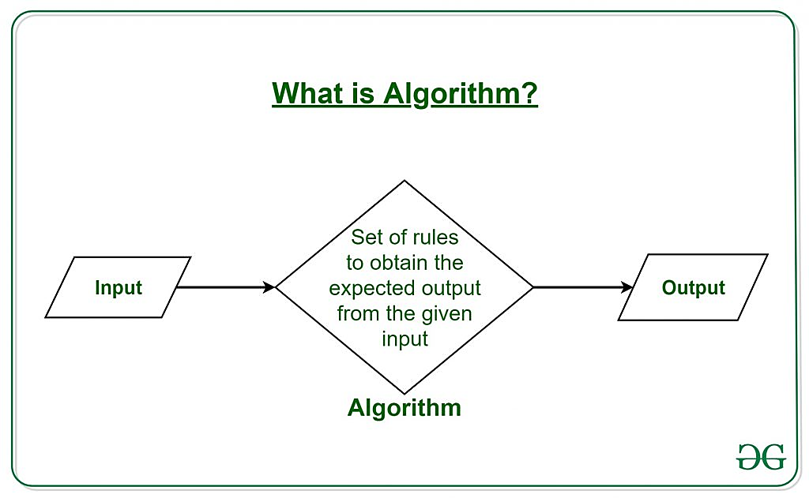
What is Algorithm?
The word Algorithm means “a process or set of rules to be followed in calculations or other problem-solving operations”. Therefore Algorithm refers to a set of rules/instructions that step-by-step define how a work is to be executed upon in order to get the expected results.

Slide 11
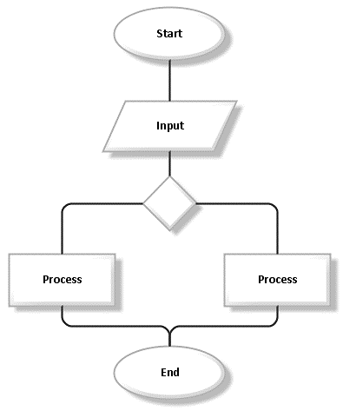
Flowchart
A flowchart is a graphical representation of an algorithm. Programmers often use it as a program-planning tool to solve a problem. It makes use of symbols which are connected among them to indicate the flow of information and processing. The process of drawing a flowchart for an algorithm is known as “flowcharting”.
Example: Draw a flowchart to input two numbers from the user and display the largest of two numbers

Slide 12
Algorithm | Flowchart
Algorithm is step by step procedure to solve the problem. | Flowchart is a diagram created by different shapes to show the flow of data.
Algorithm is complex to understand. | Flowchart is easy to understand.
In algorithm plain text are used. | In flowchart, symbols/shapes are used.
Algorithm is easy to debug. | Flowchart it is hard to debug.
Algorithm is difficult to construct. | Flowchart is simple to construct.
Algorithm does not follow any rules. | Flowchart follows rules to be constructed.
Algorithm is the pseudo code for the program. | Flowchart is just graphical representation of that logic.

Slide 13
Pseudocode
Pseudocode is an informal way of programming description that does not require any strict programming language syntax or underlying technology considerations. It is used for creating an outline or a rough draft of a program. Pseudocode summarizes a program’s flow, but excludes underlying details. System designers write pseudocode to ensure that programmers understand a software project's requirements and align code accordingly.

Slide 14
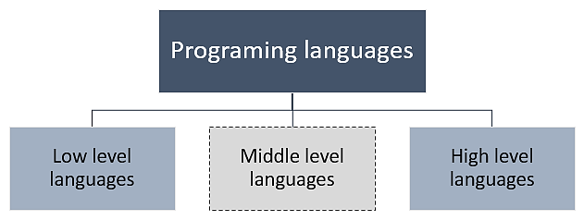
Classification of programming languages
Programming languages are basically classified into two main categories – Low level language and High level language. However, there also exists another category known as Middle level language. Every programming language belongs to one of these category and sub-category.

Slide 15
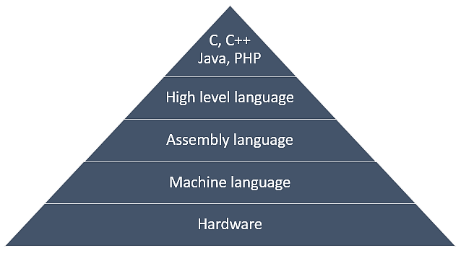
Below image describes the abstraction level of programming languages from hardware. As you can see machine language provides no abstraction. Assembly language provide less abstraction from the hardware. Whereas high level language provides a higher level of abstraction.

Slide 16
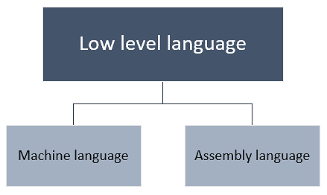
Low level languages
Low level language abbreviated as LLL, are languages close to the machine level instruction set. They provide less or no abstraction from the hardware. A low-level programming language interacts directly with the registers and memory. Since, instructions written in low level languages are machine dependent. Programs developed using low level languages are machine dependent and are not portable. Low level language does not require any compiler or interpreter to translate the source to machine code. An assembler may translate the source code written in low level language to machine code. Low level languages are further classified in two more categories

Slide 17
Machine language
Machine language is closest language to the hardware. It consists set of instructions that are executed directly by the computer. These instructions are a sequence of binary bits. Each instruction performs a very specific and small task. Instructions written in machine language are machine dependent and varies from computer to computer.
Example: SUB AX, BX = 00001011 00000001 00100010 is an instruction set to subtract values of two registers AX and BX.
Assembly language
Assembly language is an improvement over machine language. Similar to machine language, assembly language also interacts directly with the hardware. Instead of using raw binary sequence to represent an instruction set, assembly language uses mnemonics.

Slide 18
Advantages of low level languages
Programs developed using low level languages are fast and memory efficient.
Programmers can utilize processor and memory in better way using a low level language.
There is no need of any compiler or interpreters to translate the source to machine code. Thus, cuts the compilation and interpretation time.
Low level languages provide direct manipulation of computer registers and storage.
It can directly communicate with hardware devices.
Disadvantages of low level languages
Programs developed using low level languages are machine dependent and are not portable.
It is difficult to develop, debug and maintain.
Low level programs are more error prone.
Low level programming usually results in poor programming productivity.
Programmer must have additional knowledge of the computer architecture of particular machine, for programming in low level language.

Slide 19
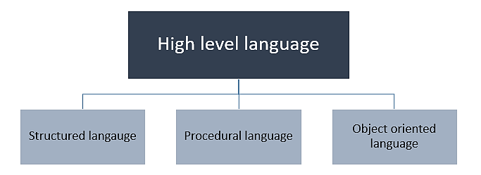
High level languages
High level language is abbreviated as HLL. High level languages are similar to the human language. Unlike low level languages, high level languages are programmers friendly, easy to code, debug and maintain.
High level language provides higher level of abstraction from machine language. They do not interact directly with the hardware. Rather, they focus more on the complex arithmetic operations, optimal program efficiency and easiness in coding.

Slide 20
Advantages of High level language
High level languages are programmer friendly. They are easy to write, debug and maintain.
It provide higher level of abstraction from machine languages.
It is machine independent language.
Easy to learn.
Less error prone, easy to find and debug errors.
High level programming results in better programming productivity.
Disadvantages of High level language
It takes additional translation times to translate the source to machine code.
High level programs are comparatively slower than low level programs.
Compared to low level programs, they are generally less memory efficient.
Cannot communicate directly with the hardware.

Slide 21
Low level language | High level language
They are faster than high level language. | They are comparatively slower.
Low level languages are memory efficient. | High level languages are not memory efficient.
Low level languages are difficult to learn. | High level languages are easy to learn.
Programming in low level requires additional knowledge of the computer architecture. | Programming in high level do not require any additional knowledge of the computer architecture.
They are machine dependent and are not portable. | They are machine independent and portable.
They provide less or no abstraction from the hardware. | They provide high abstraction from the hardware.
They are more error prone. | They are less error prone.
Debugging and maintenance is difficult. | Debugging and maintenance is comparatively easier.
They are generally used for developing system software’s (Operating systems) and embedded applications. | They are used to develop a variety of applications such as – desktop applications, websites, mobile software’s etc.

Slide 22
Applications of DBMS
Database is a collection of related data and data is a collection of facts and figures that can be processed to produce information.
Mostly data represents recordable facts. Data aids in producing information, which is based on facts. For example, if we have data about marks obtained by all students, we can then conclude about toppers and average marks.
A database management system stores data in such a way that it becomes easier to retrieve, manipulate, and produce information. Following are the important characteristics and applications of DBMS.
ACID Properties − DBMS follows the concepts of Atomicity, Consistency, Isolation, and Durability (normally shortened as ACID). These concepts are applied on transactions, which manipulate data in a database. ACID properties help the database stay healthy in multi-transactional environments and in case of failure.
Multiuser and Concurrent Access − DBMS supports multi-user environment and allows them to access and manipulate data in parallel. Though there are restrictions on transactions when users attempt to handle the same data item, but users are always unaware of them.

Slide 23
Multiple views − DBMS offers multiple views for different users. A user who is in the Sales department will have a different view of database than a person working in the Production department. This feature enables the users to have a concentrate view of the database according to their requirements.
Security − Features like multiple views offer security to some extent where users are unable to access data of other users and departments. DBMS offers methods to impose constraints while entering data into the database and retrieving the same at a later stage. DBMS offers many different levels of security features, which enables multiple users to have different views with different features. For example, a user in the Sales department cannot see the data that belongs to the Purchase department. Additionally, it can also be managed how much data of the Sales department should be displayed to the user. Since a DBMS is not saved on the disk as traditional file systems, it is very hard for miscreants to break the code.

Slide 24
Basis | DBMS Approach | File System Approach
Meaning | DBMS is a collection of data. In DBMS, the user is not required to write the procedures. | The file system is a collection of data. In this system, the user has to write the procedures for managing the database.
Sharing of data | Due to the centralized approach, data sharing is easy. | Data is distributed in many files, and it may be of different formats, so it isn't easy to share data.
Data Abstraction | DBMS gives an abstract view of data that hides the details. | The file system provides the detail of the data representation and storage of data.
Security and Protection | DBMS provides a good protection mechanism. | It isn't easy to protect a file under the file system.
Integrity Constraints | Integrity Constraints are easy to apply. | Integrity Constraints are difficult to implement in file system.
Data Models | In the database approach, 3 types of data models exist: Hierarchal data models Network data models Relational data models | In the file system approach, there is no concept of data models exists.

Slide 25
Concurrency Problems | DBMS takes care of Concurrent access of data using some form of locking. | In the File system, concurrent access has many problems like redirecting the file while deleting some information or updating some information.
Where to use | Database approach used in large systems which interrelate many files. | File system approach used in large systems which interrelate many files.
Cost | The database system is expensive to design. | The file system approach is cheaper to design.
Data Redundancy and Inconsistency | Due to the centralization of the database, the problems of data redundancy and inconsistency are controlled. | In this, the files and application programs are created by different programmers so that there exists a lot of duplication of data which may lead to inconsistency.
Recovery Mechanism | DBMS provides a crash recovery mechanism, i.e., DBMS protects the user from system failure. | The file system doesn't have a crash mechanism, i.e., if the system crashes while entering some data, then the content of the file will be lost.
Manipulation Techniques | DBMS contains a wide variety of sophisticated techniques to store and retrieve the data. | The file system can't efficiently store and retrieve the data.

Slide 26
Structure | The database structure is complex to design. | The file system approach has a simple structure.
Data Independence | In this system, Data Independence exists, and it can be of two types.Logical Data Independence Physical Data Independence | In the File system approach, there exists no Data Independence.
Flexibility | Changes are often a necessity to the content of the data stored in any system, and these changes are more easily with a database approach. | The flexibility of the system is less as compared to the DBMS approach.
Examples | Oracle, SQL Server, Sybase etc. | Cobol, C++ etc.

